Slide 1

Z-302: Managing and Behavior in Organizations
Dr. David H. Tobey

Slide 2
Class Agenda
Introductions
Review of Syllabus
Tools of the Trade

Slide 3
Introductions: A little about me
Ph.D. in Managerial Cognition and Talent Management
  Dissertation: Change Moments
Serial Entrepreneur – Performance-Enhancing Technology
  Guided Skilled Performance (GSP) Technology
  Potential Performance and 3-10-N Methodologies
  Assessment-Driven Accelerated Performance Training Solution (ADAPTS)
Co-Principal Investigator, National CyberWatch Center
Research Interests
  Accelerated learning
  Student and Professional Engagement
  Brain-Based Change
  Risk assessment and crisis response

Slide 4
My Assumptions
You expect this course and the instructor to help you further your achievement of your career goals
Every capability you need to do well in this course you already possess
You want the class to be run as similarly as possible to what really happens in the business world and you want to be treated as a responsible adult
Each one of you is different, with different strengths, weaknesses, and preferences – the better I get to know you, the better I can help you

Slide 5
WIIFM – How will the course help you succeed?
“To live means to experience – through doing, feeling, thinking. Experience takes place in time, so time is the ultimate scarce resource we have. Over the years, the content of experience will determine the quality of life. Therefore, one of the most essential decisions any of us can make is about how one’s time is allocated or invested.”
-- Mihaly Csizkszentmihalyi,
Finding Flow: The psychology of engagement with everyday life
How can I achieve my goals?
How do I develop skills that can allow me to rise to the top of my chosen field?
How can I identify and remove constraints to achieving excellence?
How do I determine the best course of action for any problem or challenge?
How can I create a fulfilling and engaging career?

Slide 6
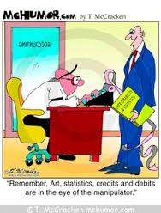
How do I excel in this course?
Observe
Think critically
  test assumptions
  look between the lines
  uncover hidden agendas
  expose sacred cows
Contribute insights
  Complete assignments according to the instructions and submitted on time
  Evidence-based analysis
  Critical discussion posts

Slide 7
How is this course like the real world?
Problem-finding, analysis and defensible solution recommendations to develop evidence-based analytical skills
Come prepared to critically analyze, debate, and discuss current issues, challenges, theories, and findings from your reading and site observations
Insightful and informed debate that demonstrates prized critical thinking, teamwork and problem-solving expertise

Slide 8
Introductions – Tell us about you
Name
What is your passion? If you had no financial needs, and could devote your time to what you love to do most, what would that be?
I wish I could figure out why people ______.

Slide 9
Syllabus Review
Becoming an Evidence-Based Analyst

Slide 10
Tools of the Trade (Free!!)
Becoming an Evidence-Based Analyst

Slide 11
Google Scholar
https://scholar.google.com
  Settings, Library Links
  Accessing articles
    Direct links
    Full Text @ IU South Bend
      Article
      Journal
  Cite
  Cited By
  Related searchers
  Create alert

Slide 12
Zotero
https://www.zotero.org
  Cloud vs. Desktop download
  Auto-generated in-text and bibliography citations
  Group libraries

Slide 13
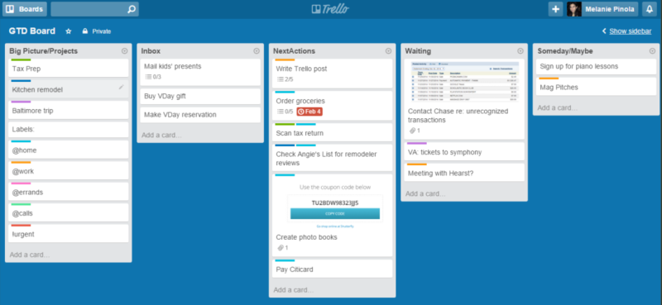
Getting Things Done
Recommended book: http://gettingthingsdone.com/
LifeHacker: How to Organize Your Entire Life with Trello

Slide 14
Evidence Based Analysis Tools
Evidence Based Management Google+ Community
  https://plus.google.com/communities/111941005350469184924
Center for Evidence-Based Management
  https://www.cebma.org/

Slide 15



Your Brain (The How to Guide)

Slide 16
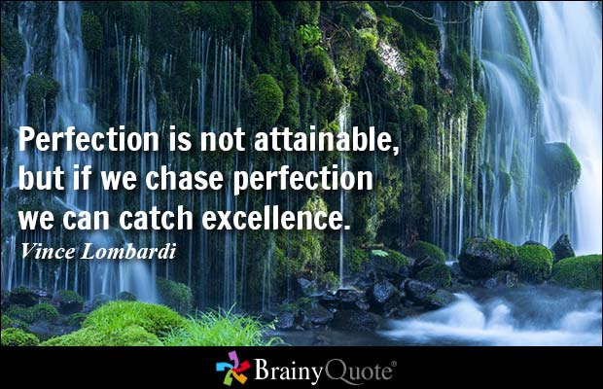
Progress Not Perfect

Slide 17
Practicing
Evidence-Based Analysis
Becoming an Evidence-Based Analyst

Slide 18
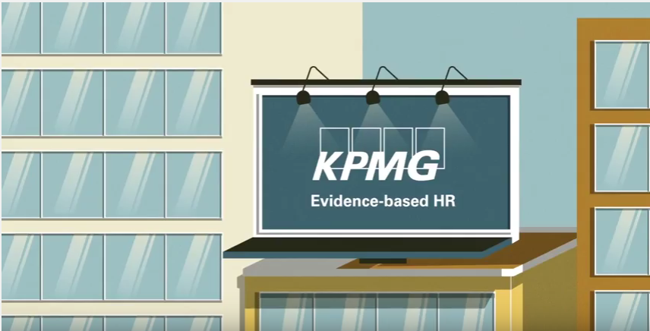
Why EBA? Market Differentiator
The top companies are using evidence-based analysis to promote how they are the best of the best.
Notes:
https://www.youtube.com/watch?v=0IUgsCAu3ic

Slide 19

EBA Skill: Evaluating Claims
DEFINITIONS
Claim: 1.) A debatable statement that something is true or is the case.
OR
2.) A statement requiring “proof” before you accept it as true (this type of claim is often used in math or legal proceedings)
Evidence: Any factual information presented to support a claim.
Undisputable facts are not claims because claims MUST be debatable. Instead, facts are used as pieces of evidence to help a person show support that their claim is true or correct. The facts, themselves, may be questioned by further evidence causing reservations about the claim.
Claim
Evidence
Evidence
Evidence
Like the legs of a stool, strong evidence “holds up” or supports your claim.
SOURCE: Boston Debate League, “Evidence Based Argumentation” http://www.bostondebate.org/eba/

Slide 20
Evaluating Claims (Method)
Definitive ....Defines or characterizes a term or concept
  “Spinach is a green, leafy vegetable”
  Debatable in terms of measured characteristics
Evaluative …Express an opinion or belief about what ought to be true or what ought to be done.
  “Spinach should be eaten every day”
  Not debatable
Designative or Advocative … Present evidence for the predicted factor relationships causing, solving or limiting the likely production of an outcome
  “Spinach will improve your health more than chocolate.”
  Debatable in terms of the probability or size of the predicted effect

Slide 21
Evaluating Claims (Example)
Claim: Spinach will improve your health more than chocolate.
Supporting Facts: (Boston Debate League, “Evidence Based Argumentation”)
One cup of spinach only has 7 calories while only 1 ounce of dark chocolate has 150 calories.
Chocolate has caffeine in it, but spinach does not.
One cup of spinach only has .1 gram of fat while only 1 ounce of dark chocolate has 9 grams of fat.
Would you agree that Spinach is always better for your health than chocolate?
Reservations: (What does an evidence-based analysis suggest?)
Scholar Search: "dark chocolate" spinach health benefits
Experimental (high-quality) studies offer conflicting evidence, specifically related to dark chocolate offering similar health benefits to spinach
  Dark chocolate contains flavonoids which protect against the risk of developing cardiovascular disease (Barnard, 2006; Engler & Engler, 2006)
  Dark chocolate in appropriate doses reduces prevalence of C-reactive protein (CRP) a reliable indicator of inflammation associated with coronary heart disease (di Giuseppe et al., 2008)

Slide 22
EBA Skill: Rating Evidence Quality
Quality | Type of paper | Purpose
0 | Theory or Essay | Make claims and supporting statements without conducting a study
1 | Expert opinion or (selective) qualitative literature review | A narrative listing/evaluation of information (opinion or publication) backing a claim
2 | Case study or uncontrolled observation | A narrative description of evidence to back a claim from a detailed study in one setting
3 | Case comparison or meta-synthesis (systematic review) | A narrative synthesis of evidence from multiple settings that backs a claim
4 | Retrospective (cross-sectional) cohort study | One-time measure of others’ opinions using a survey or other observation to obtain correlations
5 | Prospective (longitudinal) cohort study | Repeated measure of others’ opinions using a survey or other observation to obtain correlations
6 | Quasi- or non-randomized experiment | Selectively sampled measure of predictive relationships in a natural setting using statistical controls to obtain direct and indirect effects from a model comparison
7 | Randomized controlled experimental study | Randomly sampled measure of predictive relationships in a controlled experimental setting to obtain difference scores
8 | Meta-analysis | A quantitative synthesis of evidence to produce corrected correlations (ρ) of predicted relationships
Backing
Grounding

Slide 23
Rating Evidence Quality (Method)
Search for a Method section
  No? Purpose is to propose or review claims (0-1 rating)
    Search/scan paper for “review” in the Abstract or first section of the paper
    Is purpose of the article a review of prior research? (Yes, 1 rating; No, zero rating)
  Yes? Purpose is to present evidence (2-8 rating)
Search Results or Findings section for statistical tables
  No? Purpose is a Qualitative study (2-3 rating)
    Search Method Section for mention of single case setting (Yes, 2 rating, No, 3 rating)
  Yes? Purpose is a Quantitative study (4-8 rating)
    Search Results for “corrected” correlations or phi-coefficient (ρ) (Yes, 8 rating)
    Search Method for “random” sampling (Yes, 7 rating)
    Search Method or results “structural” or “hierarchical” model, 6 rating)
    Search Tables for “time” e.g., time 1, time 2, (Yes, 5 rating; No, 4 rating)

